Slide 1
Predicting Politeness Levels in Tweets: A Comparative Study of Neural Network Architectures
Zhuowen Fang fang255@purdue.edu
Zhaopeng Wang wang4433@purdue.edu

Slide 2
Introduction
What we did:
Detect politeness in computer-mediated communications
Employ various preprocessing methods and neural network models
Focus on the role of politeness in expressing emotions
Challenges:
Scarce availability of emoji-included datasets
Training model on a dataset without pre-existing labels
Novelty:
Incorporate GPT politeness-based features into the model
Explore politeness in expressing emotions on social media platforms

Slide 3
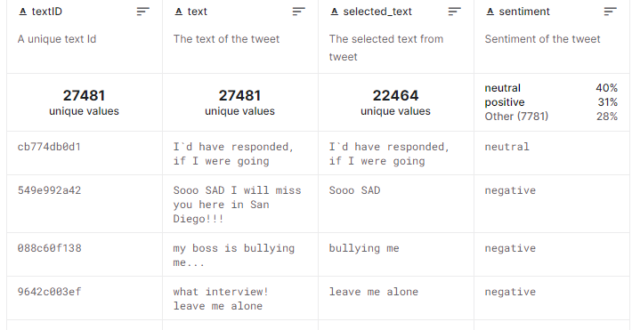
Dataset
Twitter Tweets Sentiment Dataset From Kaggle
https://www.kaggle.com/datasets/yasserh/twitter-tweets-sentiment-dataset

Slide 4
Labeling
Manual labeling cost many times since there are nearly 30k data.
Using ChatGPT-3.5-turbo API to generate the politeness label for all the data.
To ensure reliability and accuracy, we manually labeled the first 100 texts, establishing a solid baseline for comparison.
Examples:
Sons of ****, why couldn`t they put them on the releases we already bought ------2
oh Marly, I`m so sorry!! I hope you find her soon!! <3 <3 -----10
egh blah and boooooooooooo i dunno wanna go to work HANGOVERS SUCKKKKKK Im a drunk mess! -----1

Slide 5
Preprocessing
Glove, Bag of Word, BertTokenizer
Why did we choose not to use Glove after the experiment?
slangs and misspellings commonly found
Too many noises
Examples:
egh blah and boooooooooooo i dunno wanna go to work HANGOVERS SUCKKKKKK Im a drunk mess!

Slide 6
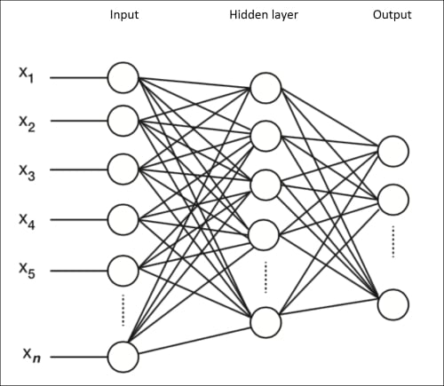

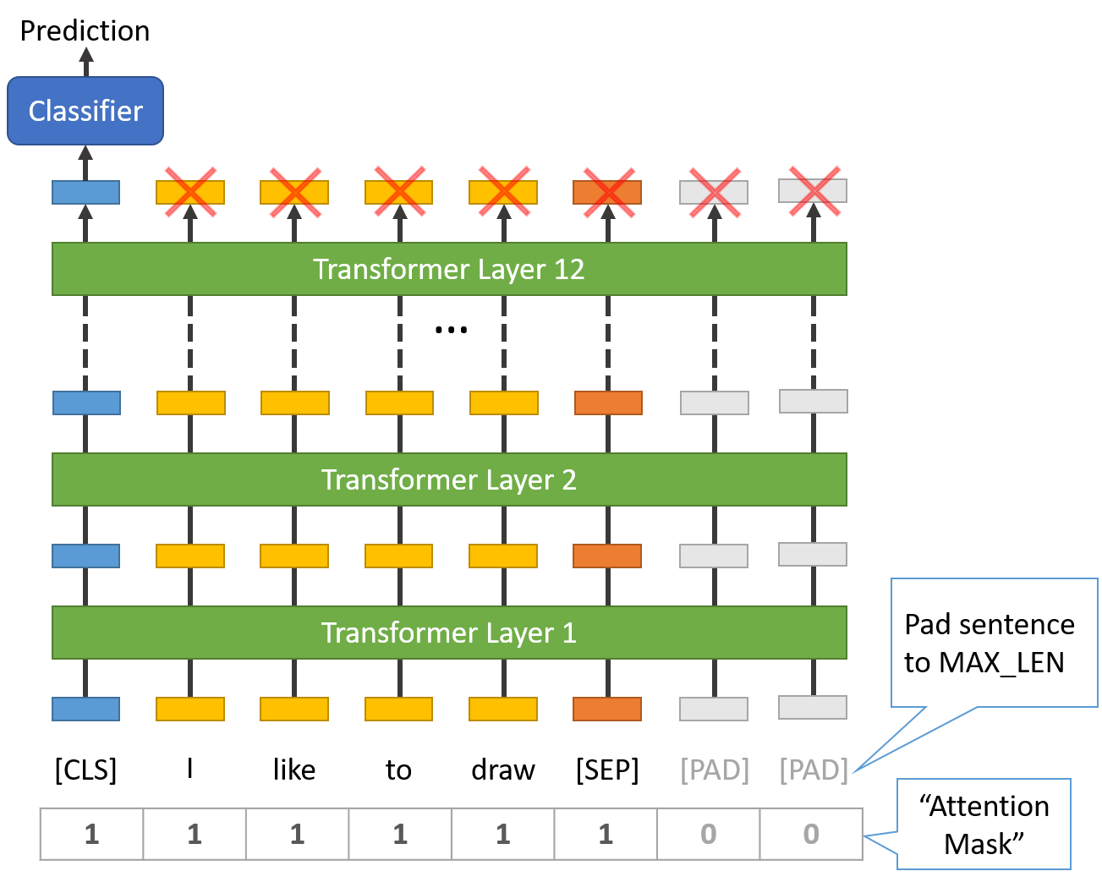
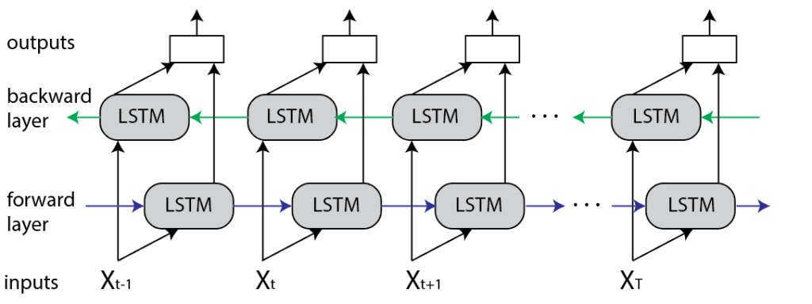
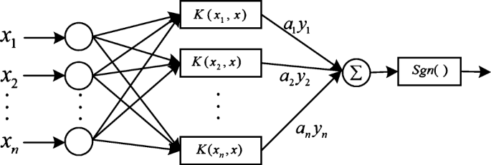
Models
NN, RNN, BiLSTM, SVM, BertForSequenceClassification
https://mccormickml.com/2019/07/22/BERT-fine-tuning/
https://link.springer.com/article/10.1007/s12517-021-07596-0
https://www.baeldung.com/cs/bidirectional-vs-unidirectional-lstm
https://medium.com/@haydarozler/another-explanation-for-the-structure-of-simple-recurrent-neural-networks-rnn-a908462065d3
https://subscription.packtpub.com/book/big+data+and+business+intelligence/9781785887215/4/ch04lvl1sec23/the-neural-network-architecture

Slide 7
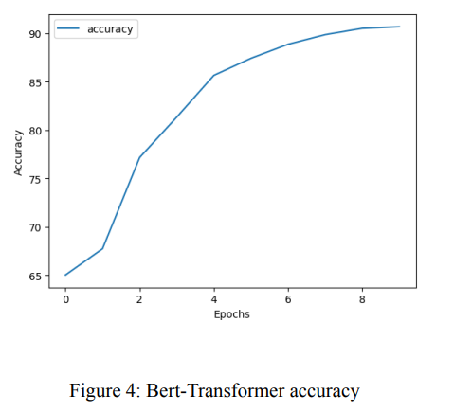
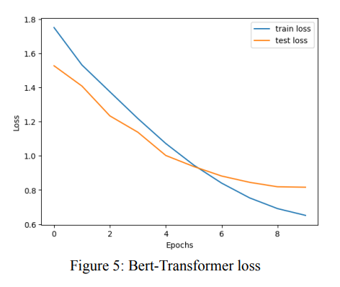
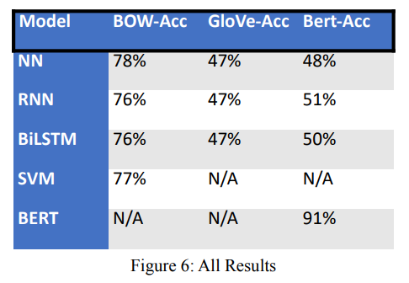
Result
The overall performance is good, we can effectively detect and classify politeness levels in a social media text with 90 percent accuracy.

Slide 8
Discussion
Future work:
Further optimize the model
explore additional NLP models
focus on defining more features for the embedding process
concentrate on domain-specific sentiment analysis tailored to various industries
explore the integration of real-time sentiment analysis in diverse applications

Slide 9
Reference
“Knowledge Uchicago.” Knowledge UChicago, https://knowledge.uchicago.edu/.H, M Yasser.
“Twitter Tweets Sentiment Dataset.” Kaggle, 8 Apr. 2022, https://www.kaggle.com/datasets/yasserh/twitter-tweets-sentiment-dataset.
Online, BPB. “Why Is Bert so Powerful?” DEV Community, DEV Community, 30 Apr. 2022, https://dev.to/bpb_online/why-is-bert-so-powerful-1kob#:~:text=This%20is%20termed%20Masked%20LM,deeper%20understanding%20of%20the%20context.
“Bert.” BERT, https://huggingface.co/docs/transformers/model_doc/bert.
A Computational Approach to Politeness with ... - Stanford University. https://nlp.stanford.edu/pubs/politeness.pdf.

Slide 10
Thank You

